Slide 1
Linux Distributions

Slide 2
Linux History
In 1969, Dennis Ritchie and Ken Thompson developed the C language and the Unix operating system at AT&T Bell Labs.
They released the source code and kept it open.
By 1975, AT&T started selling Unix commercially, about half of the source code was written by others.
After a legal battle with AT&T, Unix was released in two versions : the official AT&T Unix, and the free BSD Unix.
Development of BSD descendants like FreeBSD, OpenBSD, NetBSD, DragonFly BSD and PC-BSD is still active today.

Slide 3


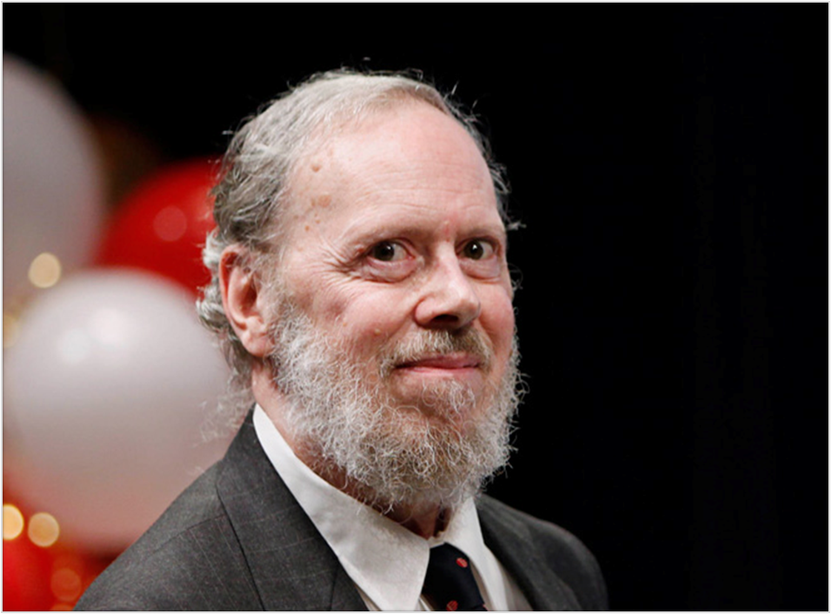





Slide 4
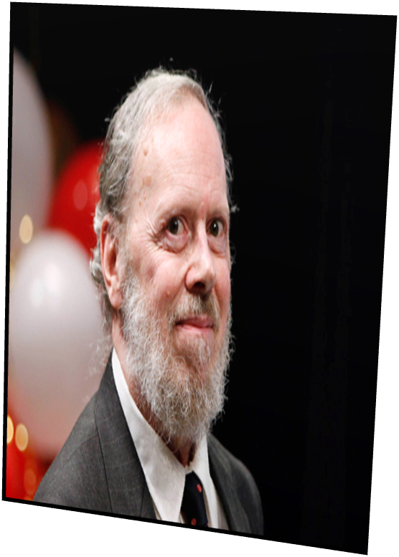
Denis Ritchie
September 9, 1941 – October 12, 2011
An American computer scientist.
Ritchie was born in Bronxville, New York.
His father was Alistair E. Ritchie, a longtime Bell Labs scientist.
He graduated from Harvard University with degrees in physics and applied mathematics.

Slide 5

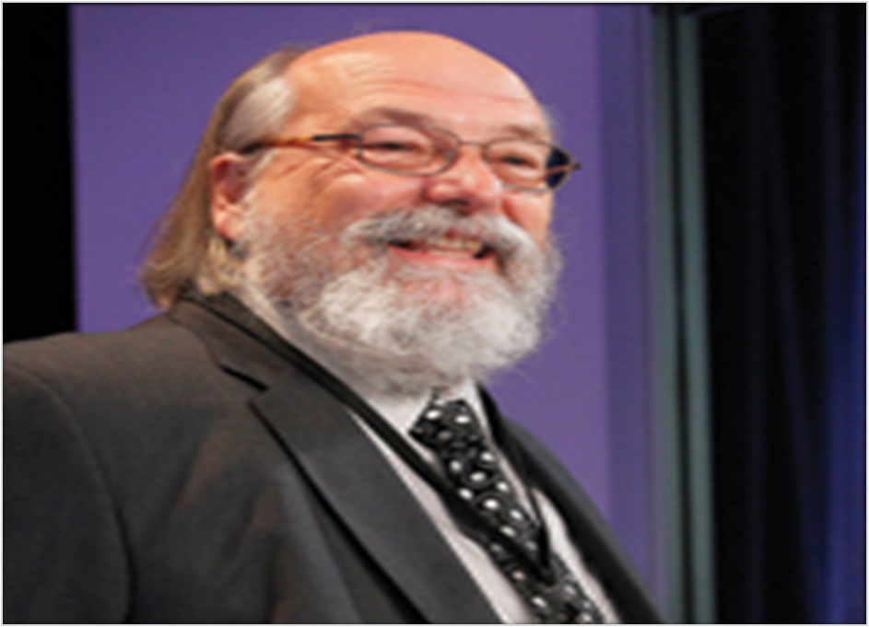

Slide 6
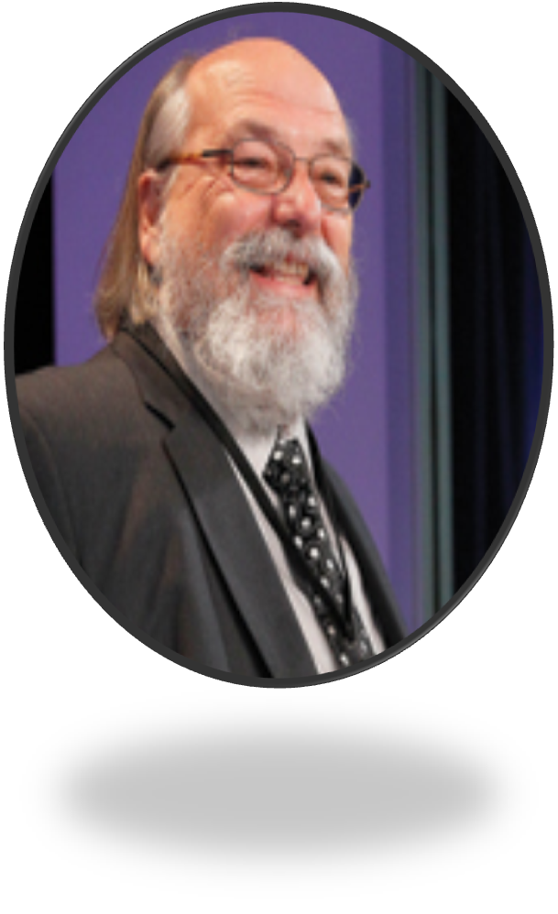
Kenneth (Ken) Thompson
Thompson was born in New Orleans on February 4, 1943
Thompson received a Bachelor of Science in 1965 and a Master's degree in 1966, both in Electrical Engineering and Computer Science, from the University of California, Berkeley.
He also invented the B programming language.
Since 2006, Thompson has worked at Google, where he co-invented the Go programming language.

Slide 7
Linux History
In the Eighties many companies started developing their own Unix: IBM created AIX, Sun SunOS (later Solaris), HP HP-UX and about a dozen other companies did the same.
Richard Stallman aimed to end this era of Unix separation by starting the GNU project (GNU is Not Unix). His goal was to make an operating system that was freely available to everyone, and where everyone could work together.
In Nineties, Linus Torvalds, a Swedish speaking Finnish student, developed a brand new POSIX compliant kernel.

Slide 8
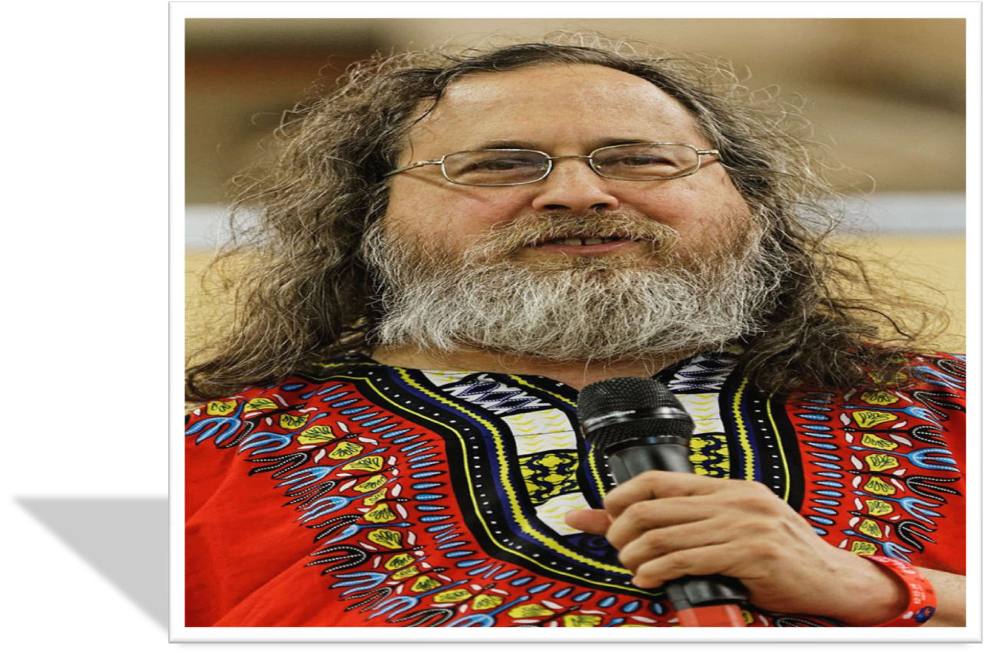

Slide 9
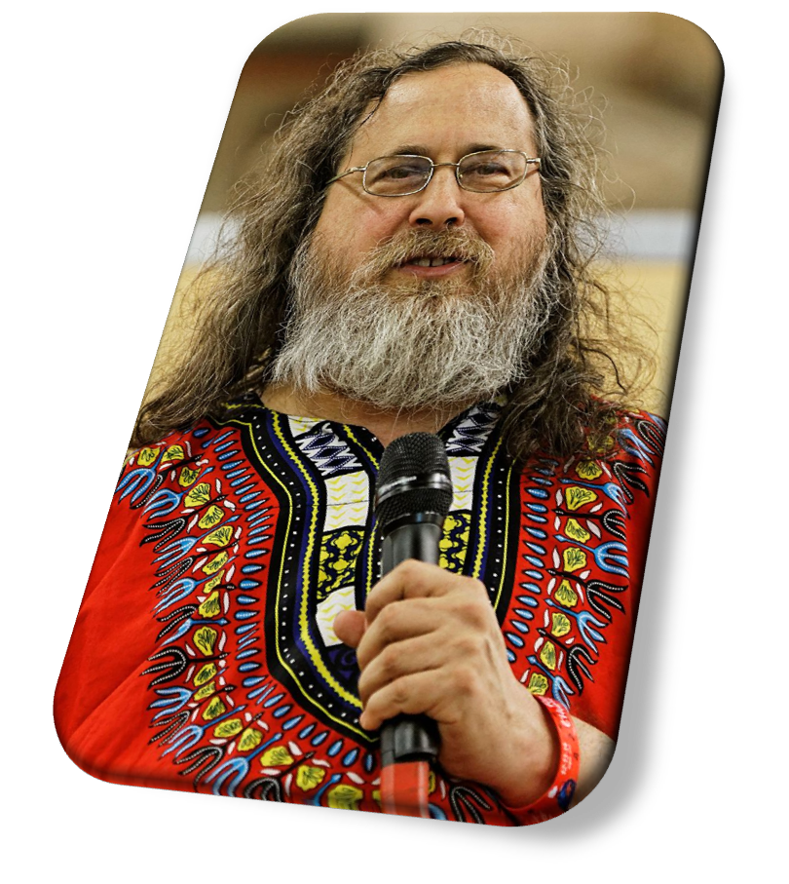
Richard Matthew Stallman
Stallman was born in New York City on March 16, 1953.
Stallman graduated from Harvard earning a bachelor's degree in Physics in 1974.
Stallman launched the GNU Project in September 1983 to create a Unix-like computer operating system composed entirely of free software.
The GNU Compiler Collection, the GNU Debugger and the GNU Emacs text editor were developed.
In October 1985 he founded the Free Software Foundation.

Slide 10

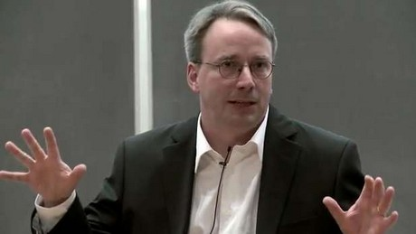

Slide 11
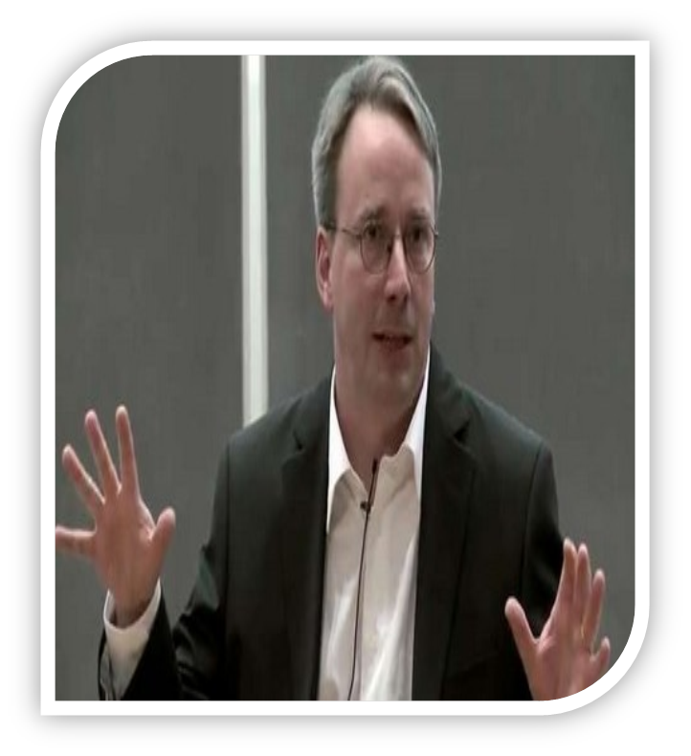
Linus Benedict Torvalds
Linus Torvalds was born in Helsinki, Finland on December 28, 1969.
Torvalds attended the University of Helsinki between 1988 and 1996, graduating with a master's degree in computer science from NODES research group.
He also created the distributed revision control system git.
Torvalds holds the "Linux" trademark and monitors the use of it, chiefly through the Linux Mark Institute.
Torvalds retains the highest authority to decide which new code is incorporated into the standard Linux kernel

Slide 12
Linux History
Today more than 97 percent of the world's supercomputers, more than 80 percent of all smart phones, many millions of desktop computers, around 70 percent of all web servers, a large chunk of tablet computers, and several appliances (DVD players, washing machines, DSL modems, routers, self-driving cars, space station laptops...) run Linux.
Linux is by far the most commonly used operating system in the world.

Slide 13
Linux Distributions
A Linux distribution is a collection of open source software on top of a Linux kernel.
A distribution (or short, distro) can bundle server software, system management tools, documentation and many desktop applications in a central secure software repository.
A distro aims to provide a common look and feel, secure and easy software management and often a specific operational purpose.

Slide 14
Linux Distributions
RED HAT
Red Hat is a billion dollar commercial Linux company that puts a lot of effort in developing Linux.
It was founded in 1993
It was taken over by IBM on July 9, 2019.
They are known for their excellent support.
They give their products Red Hat Enterprise Linux away for free.
However the support for the RHEL is subscription based.
While Red Hat Enterprise Linux (RHEL) is well tested before release and supported.

Slide 15
Linux Distributions
Fedora
Fedora is a Linux distribution developed by the community-supported Fedora Project which is sponsored primarily by Red Hat, a subsidiary of IBM.
Fedora contains software distributed under various free and open-source licenses and aims to be on the leading edge of free technologies.
Fedora is the upstream source of the commercial Red Hat Enterprise Linux distribution, and subsequently CentOS as well.

Slide 16
Linux Distributions
Fedora
Since the release of Fedora 30, five different editions are currently available:
Workstation, focused on the personal computer,
Server for servers,
CoreOS, focused on cloud computing,
Silverblue, focused on an immutable desktop specialized to container-based workflows
and IoT, focused on IoT devices.

Slide 17
Linux Distributions
CentOS
CentOS (Community Enterprise Operating System) is a Linux distribution that provides a free, community-supported computing platform functionally compatible with Red Hat Enterprise Linux (RHEL).
The first CentOS release in May 2004, numbered as CentOS version 2, was forked from RHEL version 2.
In January 2014, CentOS announced the official joining with Red Hat while staying independent from RHEL, under a new CentOS governing board.

Slide 18
Linux Distributions
CentOS
In December 2020, Red Hat unilaterally terminated CentOS development.
Red Hat will however continue to support the related rolling release distro, CentOS Stream instead of CentOS Linux.
Earlier it was Fedora ---→ RHEL ---→ CentOS
Now Fedora ---→ Centos Stream ---→ RHEL

Slide 19
Linux Distributions
Ubuntu
Canonical started sending out free compact discs with Ubuntu Linux in 2004.
It quickly became popular for home users (many switching from Microsoft Windows).
Canonical wants Ubuntu to be an easy to use graphical Linux desktop without need to ever see a command line.
Of course they also want to make a profit by selling support for Ubuntu.

Slide 20
Linux Distributions
Debian
There is no company behind Debian.
Instead there are thousands of well organized developers that elect a Debian Project Leader every two years.
Debian is seen as one of the most stable Linux distributions.
It is also the basis of every release of Ubuntu.
Debian comes in three versions: stable, testing and unstable.
Every Debian release is named after a character in the movie Toy Story.

Slide 21
Linux Distributions
Other Distributions
Distributions like Oracle Enterprise Linux and Scientific Linux are based on Red Hat Enterprise Linux and share many of the same principles, directories and system administration techniques.
CentOS founder, Gregory Kurtzer, created the Rocky Linux project as a successor to the original mission of CentOS.
Cloud Linux (makers of CloudLinux OS) announced a new RHEL derivative called AlmaLinux.
Linux Mint, Edubuntu and many other *buntu named distributions are based on Ubuntu and thus share a lot with Debian.
There are hundreds of other Linux distributions.

Slide 22
Linux Distributions
Special Purpose Linux Distros
BackTrack / Kali Linux – Contains tools used for ethical hacking. Helps in performing Vulnerability Assessment and Penetration Testing.
Wifislax – Contains tools used for hacking Wi-Fi networks. Used as tool for auditing Wi-Fi networks.
REMnux – Contains tools for performing Reverse Engineering of Malware / Malware analysis.
Helix – Contains tools used in incident response and digital forensics.

Slide 23

Questions???

Slide 24


